Slide 1


Visionary Course - Energy AI
Week 12
Nov 17, 2022
Sohee Kim, Giwon Sur

Slide 2


https://view.kentech.ac.kr
Week 12b – Interactive regression for road following on Jetson Nano
Notes:
Today, we will do about Interactive regression for road following on Jetson Nano

Slide 3
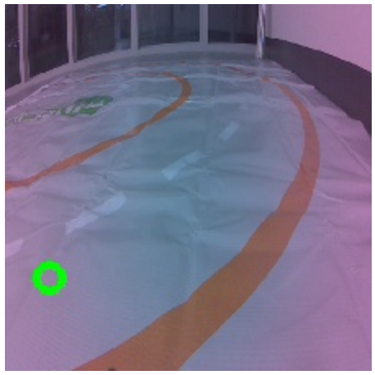
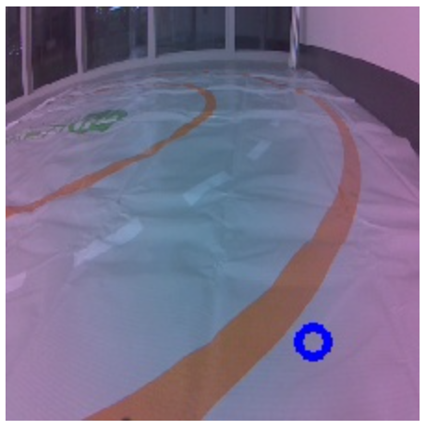
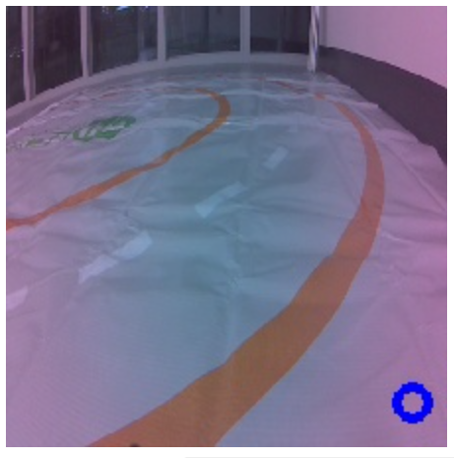
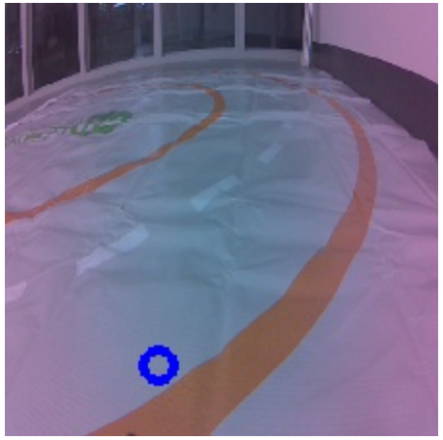
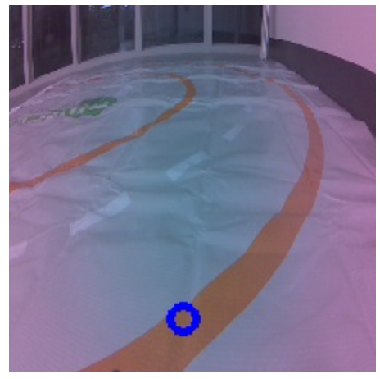
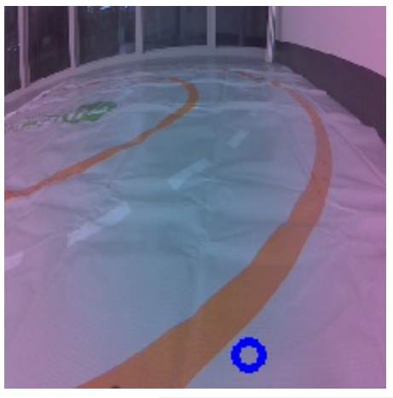

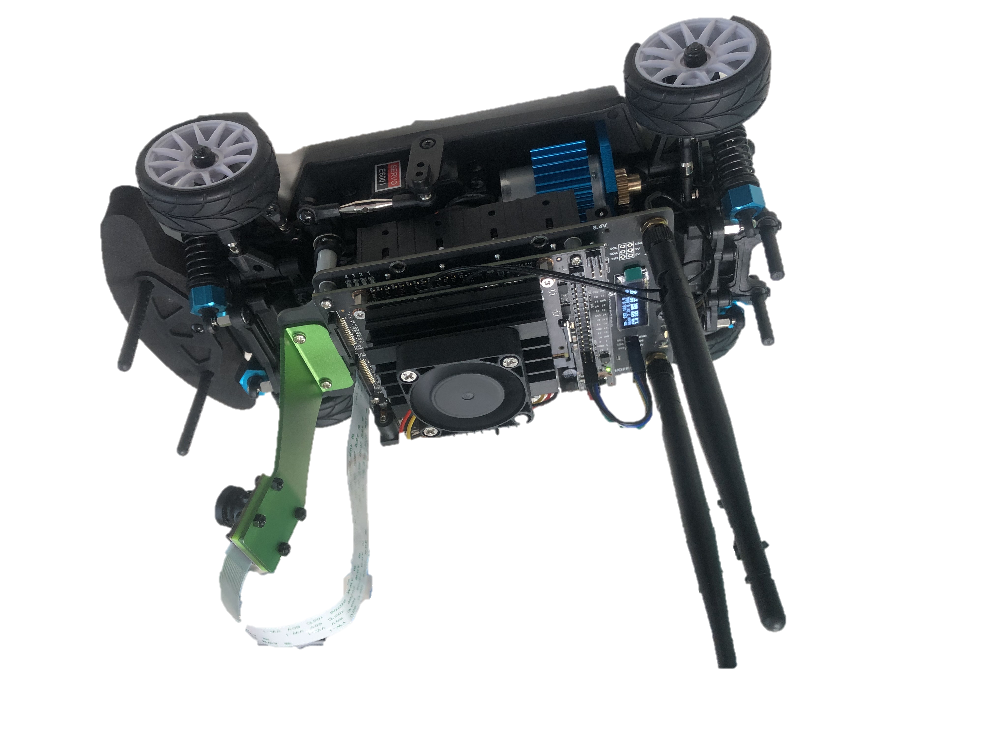
JetRacer: Let's continue autonomous driving!
Today we will train model on the road with 2D-lined track.
Train model!
Training Step #5
Training Step #4
Training Step #2
Training Step #3
Training Step #1
Green point
= Human’s annotation
= Ground Truth (GT)
Blue point
= Model’s output
= Prediction
Workspace:
“localhost:8888/lab/tree/jetracer/notebooks/interactive_regression.ipynb”
Notes:
Today we will train model on the road with 2D-lined track.
This image is from camera at jetson.
The green point indicates Human’s annotation == Ground Truth (GT)
After training model, the result will be close to the ground truth.
This Blue point indicates Model’s output == Prediction
이와 같이 학습시킬수록 더 선안으로 들어오는것을 볼 수 있습니다.
As you can see, When you train, the point comes inside of line
The Workspace is at below, the interactive regression file.

Slide 4
JetRacer: Let's continue autonomous driving!
Input image
Output:
pixel coordinate (x, y)
AI Model
Where to go?
Steering!
Deep Learning!
Controller
Notes:
When you put input image to AI Model, output will be pixel coordinate (x, y) which means Where to go.
This is the process of deep learning.
Then controller will get trained model from this process, and steering value will be set per frame.

Slide 5
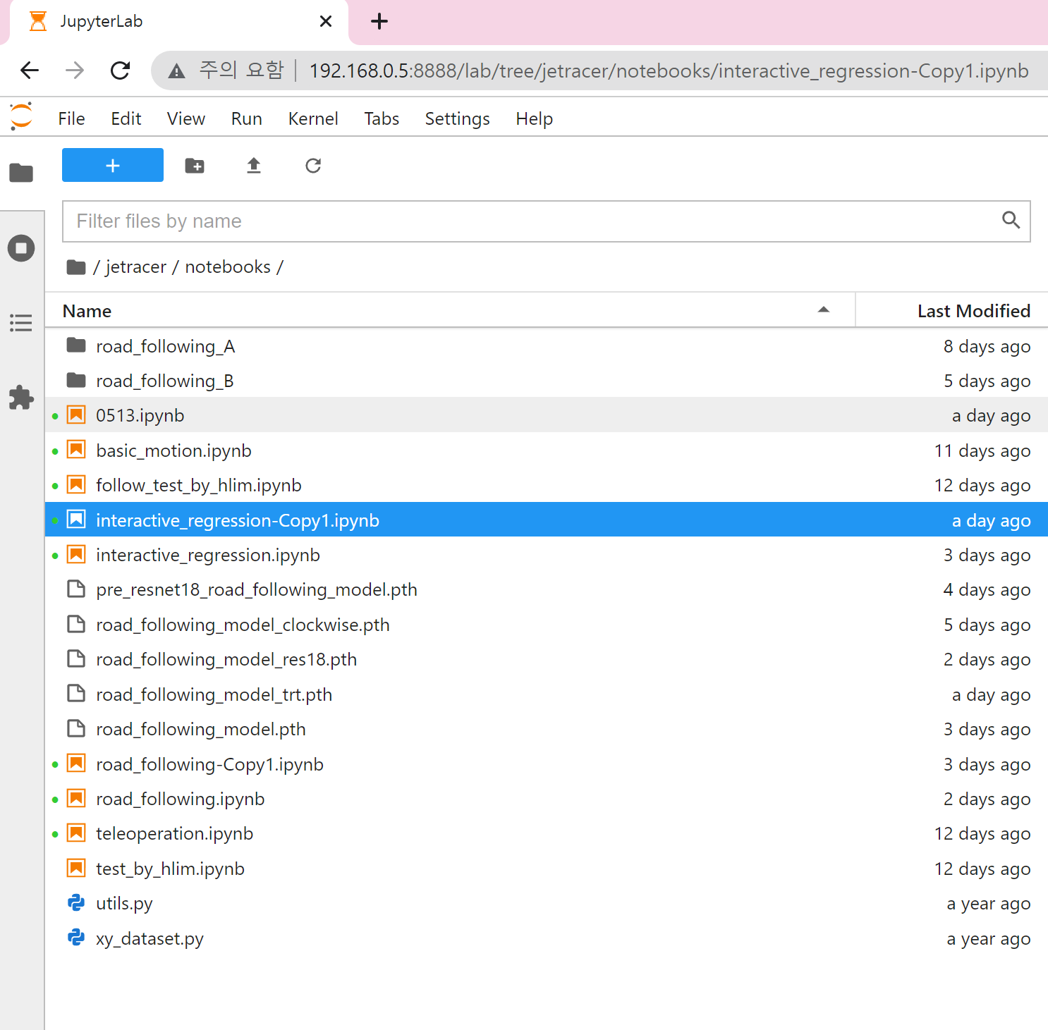
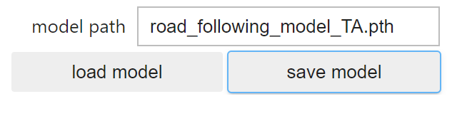
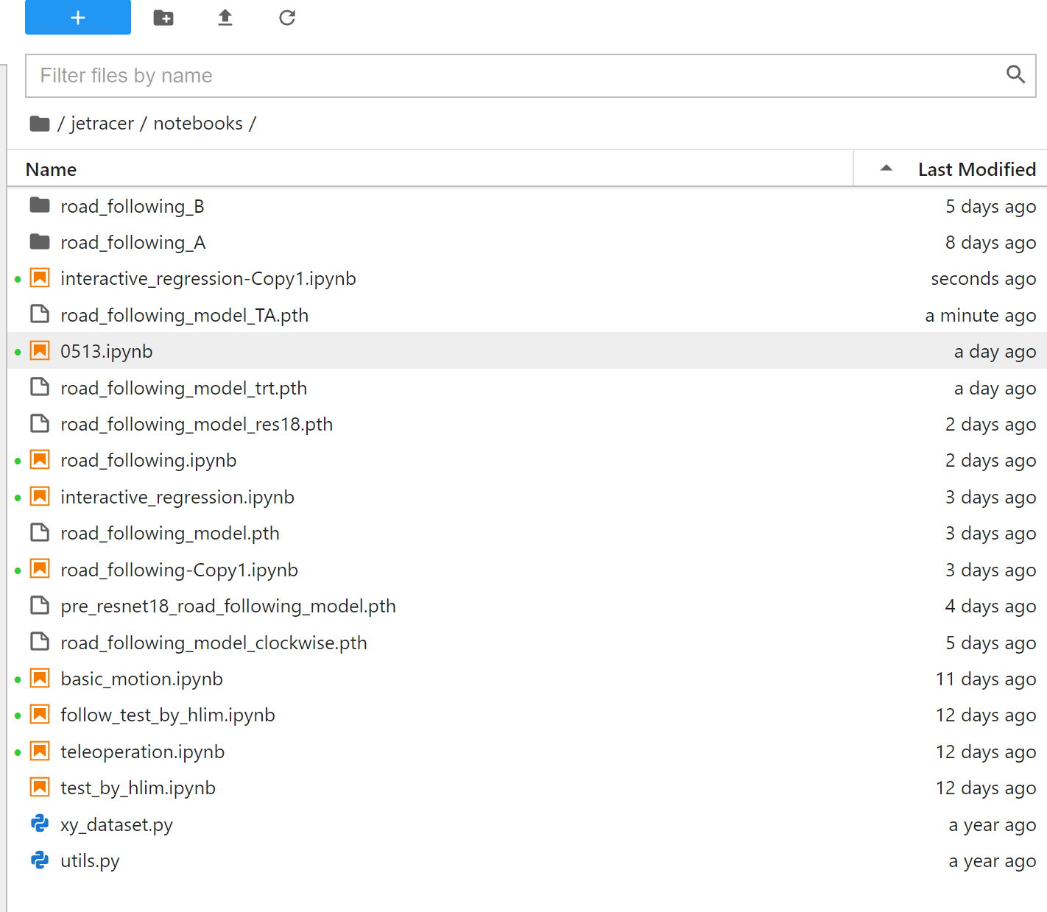
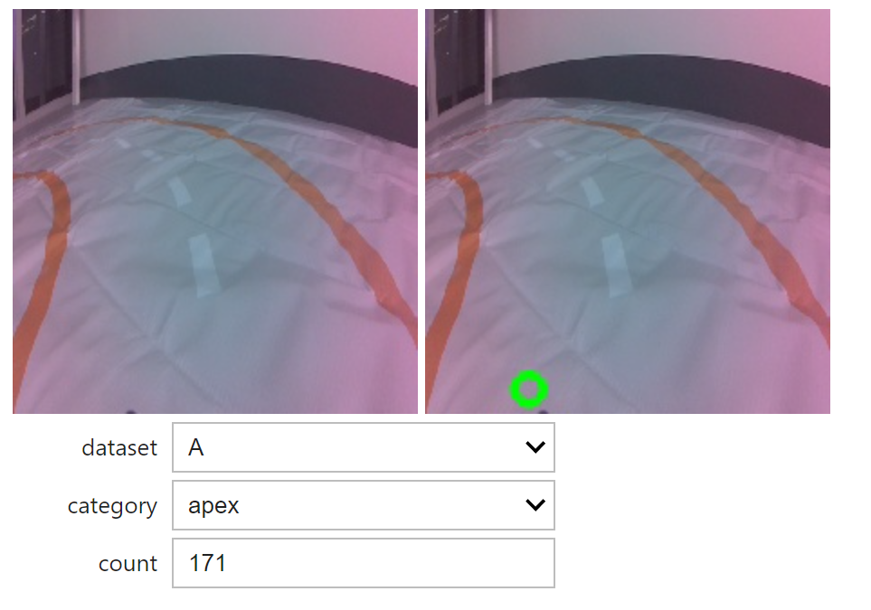
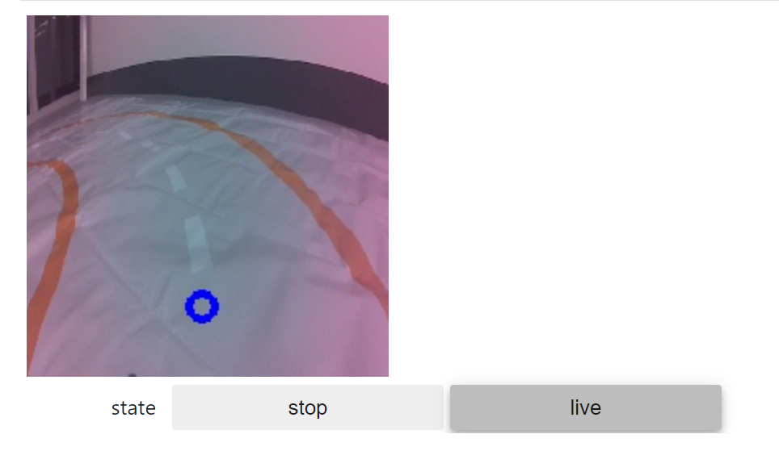
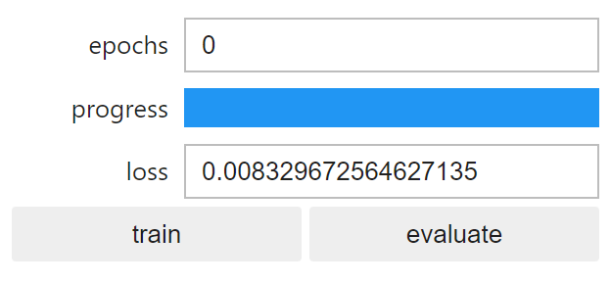
Overview of interactive_regression.ipynb
1
3
Composite dataset
Make model
2
4
Train & evaluate
Collect data
Notes:
This is overview of interactive regression file.
First ~~

Slide 6
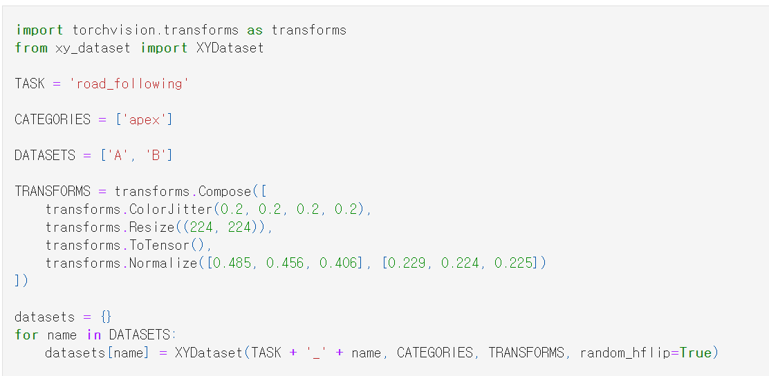
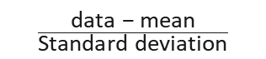
1. Composite dataset
Data augmentation
brightness, contrast, saturation, hue
mean
$$\frac{\text{data}\text{ − }\text{mean}}{\text{Standard} \text{deviation}}$$
standard
deviation
Load data if it exists
Notes:
First is about composite dataset. (데이터 구성)
There is road_following_A, B folder in this directory, and the data will be saved in here. So here DATASETS list is A and B.
Apex (Output의 차원은 1지만 2개의 vector를 저장)
원래 road_following_A, B 폴더가 있어서 여기에 데이터를 수집할것이다.
그래서 dataset 리스트에 A, B를 define 해줌
TRANSFORMS is about data augmentation. => for better training, make data transform. In here, they use color jitter, resize and normalized it.
Here ColorJitter means brightness, contrast, saturation, and hue value.
And resizing, normalizing is followed.
When normalizing, there are 3 means and standard deviation for each RGB value. It is calculated using this formula.
Then load datasets if it exists, in here it is A and B,
Dataset is the picture taken by Jetson.

Slide 7
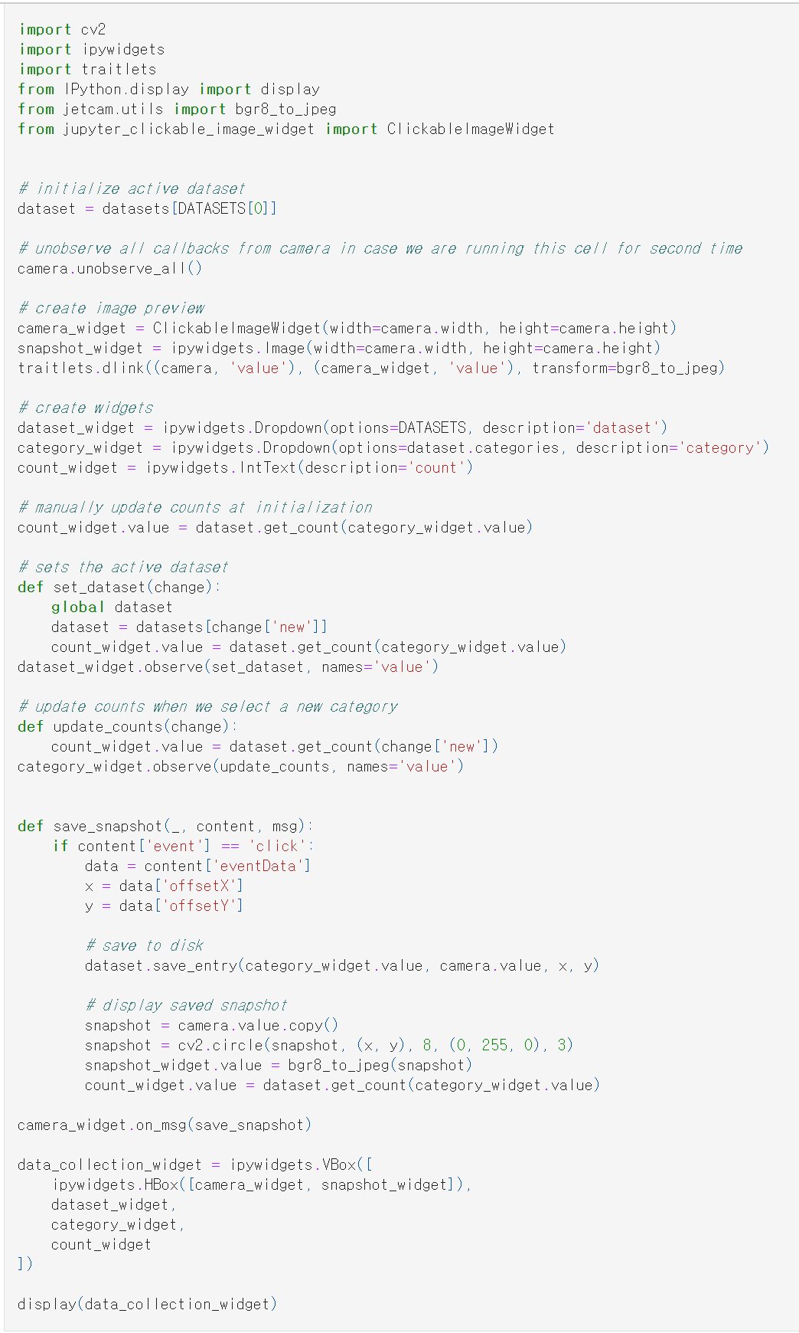
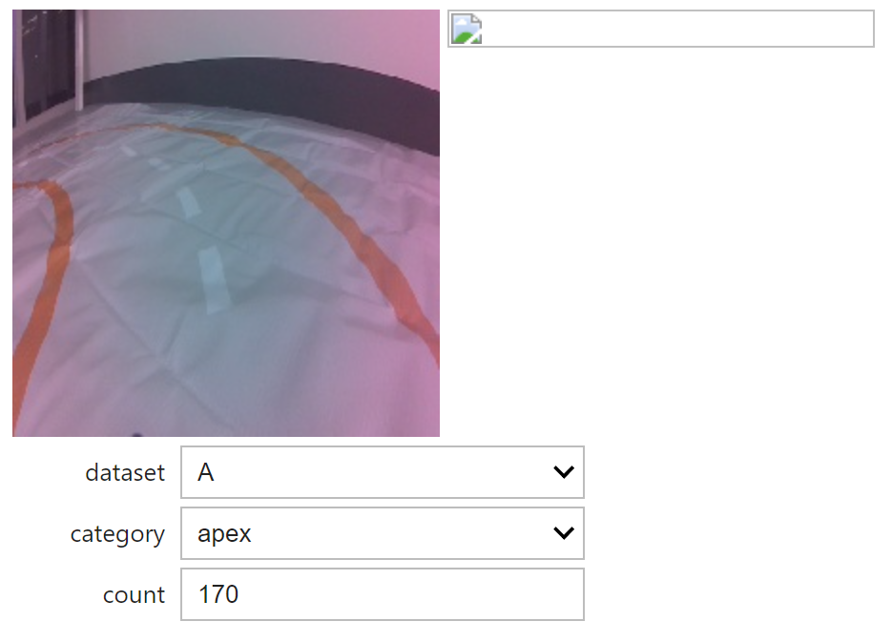
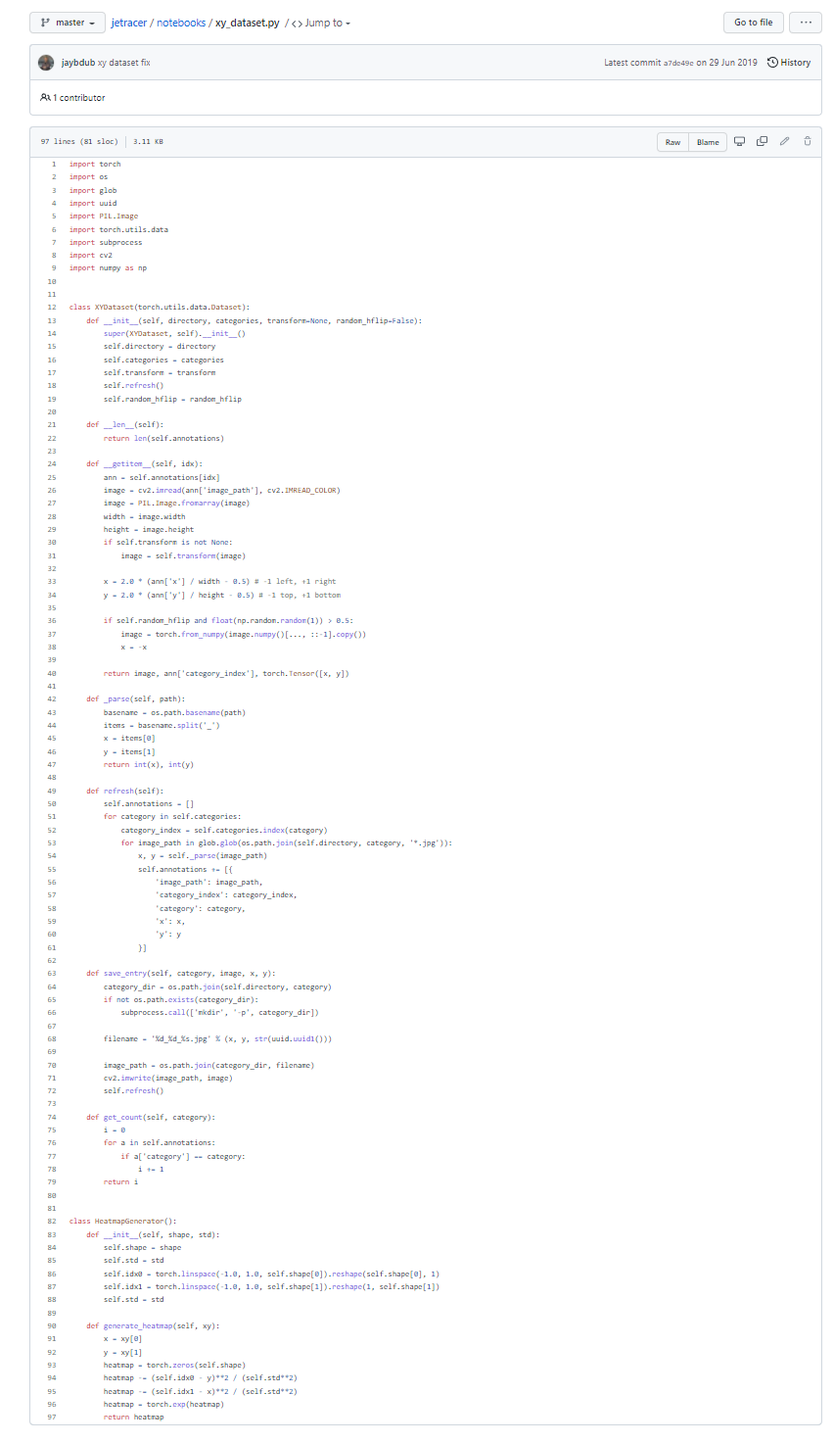
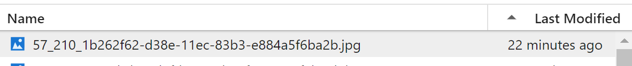
2. Collect data
Count total snapshot
x
y
Saved snapshot get coordination in the file name
Notes:
This is way how to collect data.
** When you click the image in the camera widget view, camera widget saves click location and snapshot.
이미지를 클릭했을 때 일어나는 이벤트. 이벤트는 클릭한 위치와 사진을 저장함.
** Then snapshot widget shows saved snapshots like this right image.**
저장한 사진을 보여주는 변수
In here, save_snapshot function saves snapshop to disk
** It take the x y coordinate as a name of snapshot.
** Here, count widget means number of snapshot,
In this example, it will be 171.
This count increases when you get snapshot.

Slide 8
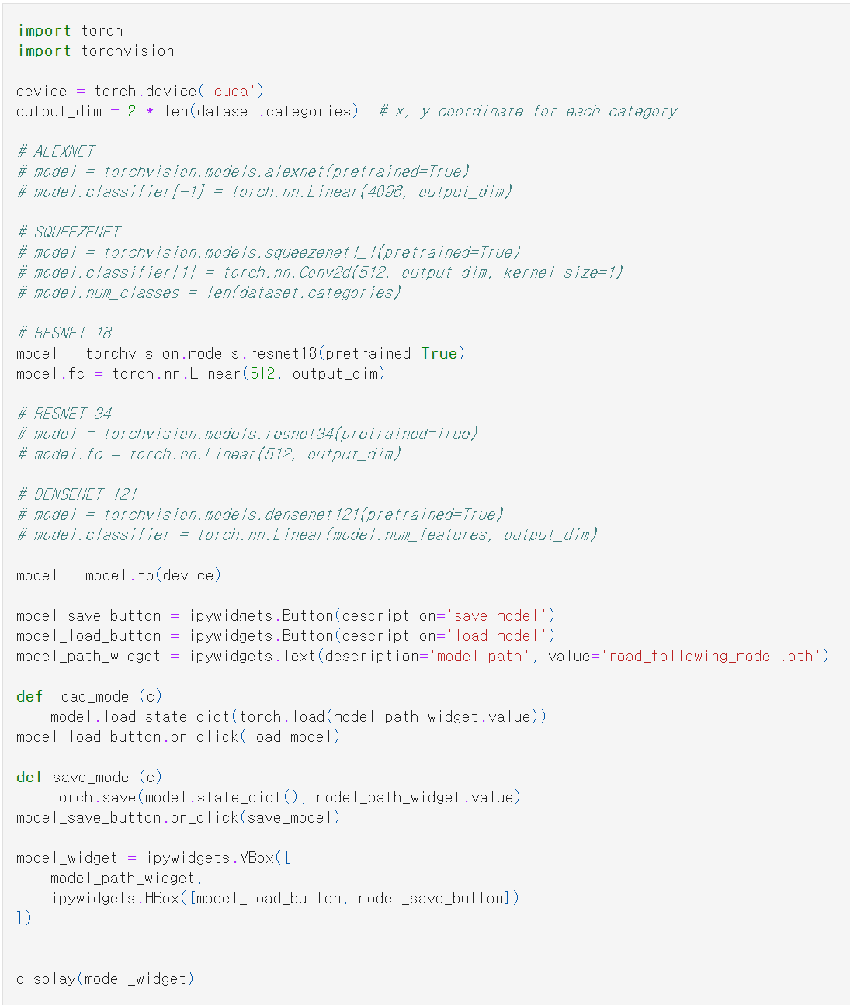
3. Define model
Declare specific model
(resnet18 here)
Set output dim’s as 2
Load model to GPU
Model’s name
Make widgets for
loading and saving model
Notes:
Third step is defining model.
This declare specific model. Torchvision has many models, but we use resnet18 here.
At fc layer of model, resnet18, output dim is set as 2 here.
Then load model to GPU. And Make widgets for loading and saving model.
You have to type Model’s name here. It will be saved here, the location you are working.

Slide 9
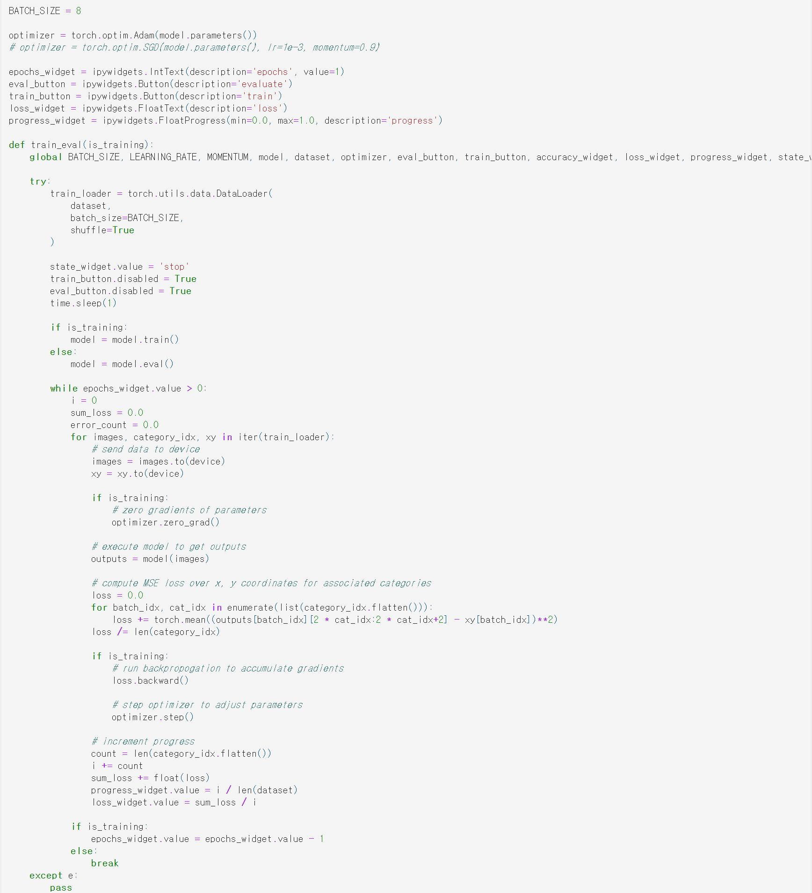
4. Train & evaluation
Notes:
Finally, you have to train and evaluate model.
This is about train and evaluation widget view.
And when you type the epochs and press the train button, it start training according to the number of the epoch you write.
You can control the Batch size, here is 8.

Slide 10
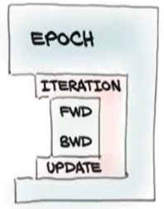
4. Train & evaluation
Epoch
Number of iterations over the entire dataset
Iteration
Mini-batch iterations
Forward
Predict output
Calculate loss
Backward
Calculate gradients and update the model (back-propagation)
Dataset: 1000 images
(batch size = 100)
. . .
Epoch:
One Epoch is when an ENTIRE dataset is passed forward and
backward through the neural network only ONCE.
Batch size:
Total number of training examples present in a single batch.
Iteration:
The number of passes to complete one epoch.
100
100
100
1-iter
2-iter
10-iter
1-epoch
Notes:
This code is about training. Overall Training mechanism is as followed. *
Like shown In this figure, Epoch surrounds the whole process, and Iteration in one epoch repeats model forward and backward.
Then what does epoch and iteration means? *
One Epoch is when an ENTIRE dataset is passed forward and backward through the neural network only ONCE.
Batch size is Total number of training examples present in a single batch.
Iteration is The number of passes to complete one epoch.
Let’s see the details of code here.
** The blue box shows the Epoch loop. Epoch is the number of iterations over the entire dataset.
** The green box shows the mini-batch iteration loop. Iteration is the number of passes to complete one epoch.
** The yellow boxes are forward operation. It predict output and calculate loss.
** The red box is backward operation. It calculate gradients and update the model.
Dataset 이 1000개의 이미지 일때 배치사이즈가 100이라면 iteration은 10번이 된다. (batch*iteration=dataset)
한 epoch에 모든 dataset train. Epoch 수만큼 데이터셋 전체를 학습한다.
Training mechanism은 다음과 같다 (우측 피겨 팝업)
Epoch가 전체를 감싸고 있고 한 이포크안에 Iteration이 여러 번 돌면서 모델 포워드와 백워드를 반복한다.
그렇다면 Epoch와 Iteration은 무얼 의미할까? (아래쪽 Epoch, Batch, Iteration 텍스트 팝업)
Epoch is ~
Batch size is ~
Iteration is ~
Let’s see the details of code here.
The blue box shows the Epoch loop. This is number of iterations over the entire dataset (Epoch 팝업)
The green box ~ (Iteration 팝업)
The yellow boxes are ~ (FWD 텍스트 팝업)
The red box is ~ (BWD 텍스트 팝업)

Slide 11
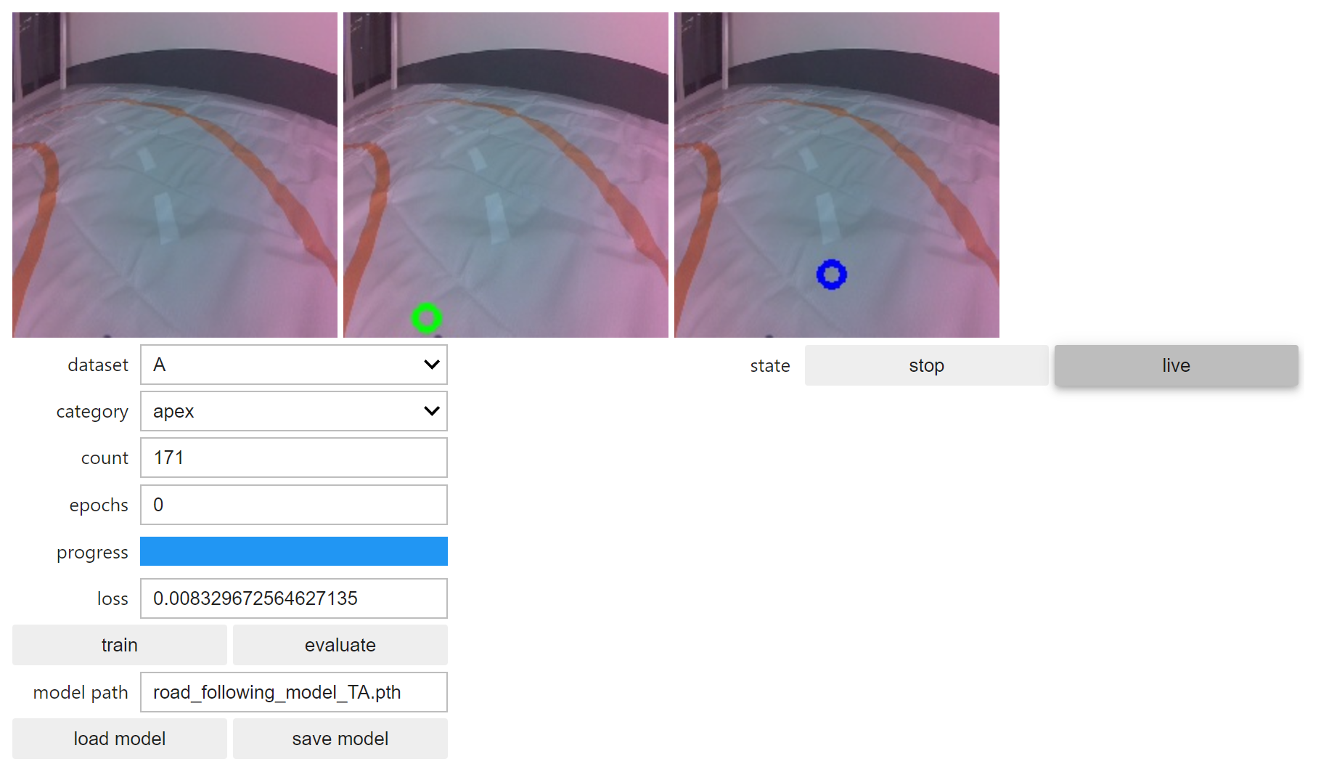
4. Train & evaluation
Don’t forget
to save!
Notes:
The result will be shown as this.
(all widget shows the dataset image and inference result)
Don’t forget to save model !

Slide 12
Experiments (Submit the report by 11/24 11:59PM )
Run interactive regression.
Q.1.1. Collect data in ‘A’ and train the model.
Q.1.2. Repeat collection and training and evaluation alternatively until the count
no larger than 30.
Q.1.3. Save the model.
Run interactive regression with more data in another dataset with a different model.
Q.2.1. Collect data in ‘B’ and train the model with a different named model from 1.
Q.2.2. Repeat collect data and training and evaluation alternatively until the count becomes 150~200.
Q.2.3. Save the model.
Change the batch size and epoch and train the model
Q.3.1. Set batch size (original 8) to 4 or 16. and train the model. Can you observe the training time is different from 2?
Q.3.2. Set epoch size 5 and train. Observe the loss changes and evaluation result in the blue circle.
Q.3.3. Again, set epoch size 10 and train. Observe the loss changes and evaluation results in the blue circle. Compared to Q.3.2. how the result change?

Slide 13
Experiments (Submit the report by 11/24 11:59PM )
Run the trained models.
Q.4.1. With the trained models, run the road following.
Q.4.2. When observing the performance, which one is better? (trained with 30 or 150~200)
Q.4.3. Run the better model, and compare the model with “road_following_model_gwsur.pth”
Train the model on different environment
Q.5.1. Place the car outside of the lane but head to the track.
Q.5.2. With the trained model, run the road following. Does the car get into the lane?
Q.5.3. If the car keeps moving outside, please train the model.
Q.5.4. Place the track in diverse places under different illumination conditions.
Does the car drive well?
Q.5.5. If the car doesn’t work well, please train the model again.
Q.5.6. Measure the lab time of your model. Make it faster using y axis! Do your best.

